Slide 1


CS-482: Introduction to BlockChain and CryptoCurrency
Lecture # 2: Introduction to BlockChain and Decentralization
Prof. Dr. Sufian Hameed
Department of Computer Science
FAST-NUCES
FAST-NUCES
Notes:
<number>

Slide 2
Overview
The History of Blockchain
Electronic Cash
Introduction to Blockchain
Generic Elements
Features of Blockchain
How Block Chain Accumulate Block
Tiers of Blockchain technology
Types of Blockchain
Benefits and Limitations
Decentralization
Methods of Decentralization
Routes to Decentralization
Blockchain and Full Ecosystem Decentralization
Smart Contracts
Decentralization Autonomous Organizations
FAST-NUCES

Slide 3
History of Blockchain
FAST-NUCES

Slide 4
The History of Blockchain
E-Cash
1984 by David Chaum
Fundamental issues Accountability and Annoymity
Used Blind Signatures and Secret Sharing
Blind signatures allow signing a document without actually seeing it
Secret sharing is a concept that allows the detection of using the same e-cash token twice (double spending).
Hash-Cash
1997 by Adam Back
PoW system to control e-mail spam
legitimate users compute a hash as a proof that they have spent a reasonable amount of computing resources before sending the e-mail
B-Money
1998 by Wei Dai
Creating money via solving computational puzzles like hash-cash
based on a peer-to-peer network where each node maintains its own list of transactions.
Bit-Gold
2005 by Nick Szabo
Solving computational puzzles to mint digital currency.
still relied on a centralized trusted authority
ISSUES:
No clear solution of disagreements between nodes
Reliance on a central trusted third party and trusted timestamping.
FAST-NUCES

Slide 5
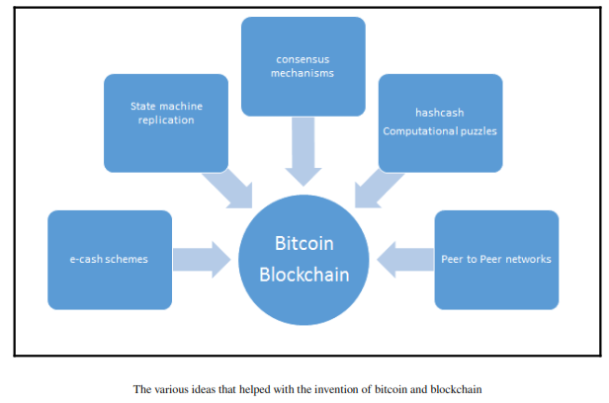
The History of Block Chain
FAST-NUCES

Slide 6
Introduction to Blockchain
FAST-NUCES

Slide 7
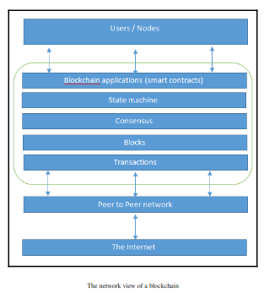
Intro to Blockchain
Blockchain at its core is a peer-to-peer distributed ledger that is cryptographically secure, append-only, immutable (extremely hard to change), and updateable only via consensus or agreement among peers.
FAST-NUCES

Slide 8
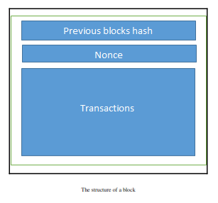
Block Structure
A block is simply a selection of transactions bundled together in order to organize them logically. It is made up of transactions and its size is variable depending on the type and design of the blockchain in use.
FAST-NUCES

Slide 9
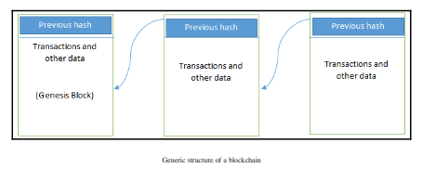
Block Structure
FAST-NUCES

Slide 10
Elements of Blockchain
Addresses
Unique identifiers that are used in a transaction on the blockchain to denote senders and recipients
Transactions
Represents a transfer of value from one address to another
Block
Peer-to-Peer Network
Scripting or Programming Language
Transaction scripts are predefined sets of commands for nodes to transfer tokens from one address to another and perform various other functions.
Virtual Machine
Allows code to be run on a blockchain
Nodes
FAST-NUCES

Slide 11
How Blockchains accumulate blocks
A node starts a transaction by signing it with its private key.
The transaction is propagated (flooded) by using much desirable Gossip protocol to peers, which validates the transaction based on pre-set criteria. Usually, more than one node is required to validate the transactions.
Once the transaction is validated, it is included in a block, which is then propagated on to the network. At this point, the transaction is considered confirmed.
The newly created block now becomes part of the ledger and the next block links itself cryptographically back to this block. This link is a hash pointer. At this stage, the transaction gets its second confirmation and the block gets its first.
Transactions are then reconfirmed every time a new block is created. Usually, six confirmations in the bitcoin network are required to consider the transaction final.
FAST-NUCES

Slide 12
Tiers of Blockchain
Blockchain 1.0
Invention of Bitcoin
Blockchain 2.0
Smartcontracts and code execution on blocks
Blockchain 3.0
Decentralized Applications beyond
Blockchain X (Generation X)
a vision of blockchain singularity where one day we will have a public blockchain service available that anyone can use just like the Google search engine. It will provide services in all realms of society.
FAST-NUCES

Slide 13
Types of Block Chains
Public Blockchain
Private Blockchain
Semi-Private Blockchain
Consortium Blockchain
FAST-NUCES

Slide 14
Benefits and Limitations
Decentralization
Transparency and Trust
Immutability
High Availability
Faster Dealing
Cost Saving
Challenges
Scalability
Adaptability
Regulation
Relatively immature technology
Privacy
FAST-NUCES

Slide 15
Decentralization
FAST-NUCES

Slide 16
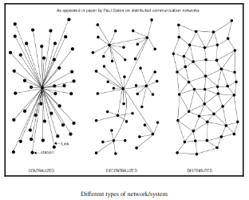
Centralized vs Distributed vs Decentralized
FAST-NUCES

Slide 17
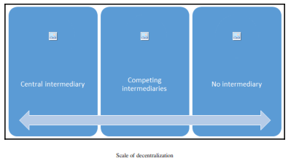
Modes of Decentralization
Disintermediation
No Intermediary
Through Competition
Service providers compete with each other in order to be selected
FAST-NUCES

Slide 18
How to Decentralize
What level of decentralization is required?
What is being decentralized?
What blockchain is used?
What security mechanism is used?
Example of Money Transfer System
Answer 1: Money transfer system.
Answer 2: Disintermediation.
Answer 3: Bitcoin.
Answer 4: Atomicity.
FAST-NUCES

Slide 19
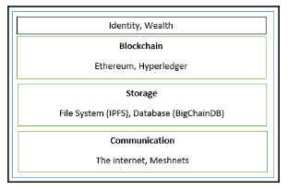
Blockchain and Full Ecosystem Decentralization
FAST-NUCES

